Slide 1
Weather Collector
CSC 420/620
Kurt Gehl, Clayton Conly, Madelynn Cook, Ken Fisher, Michael Rogers
KF

Slide 2
Overview - Relation to the Lifecycle
Analysis
Gather weather data
Create visualizations with weather data
Design
Raspberry Pi’s collect data and send to database
Development, Testing, Maintenance
How we developed the code
Where do we go from here?
KF

Slide 3
Problems
Accurate weather data is not always available
Can we provide a useful visualization of the data we collect?
Visualizations are a powerful tool for understanding data
KF

Slide 4
Alternative Solutions
Front end could be an app, or a non-visual representation of the data
This would limit the usability
Backend could be done in any number of different languages or frameworks, such as Python or Node.js
Database could be No-Sql based
This would make correlating weather data difficult
MR

Slide 5
Benefits and Drawbacks
The major benefit of this project is a greater ability to understand local weather
Better understanding of the weather can be helpful for making plans
The only drawback is the cost of buying and setting up a Raspberry Pi
MR

Slide 6
Costs
This solution is not expensive
Requirements:
Raspberry Pi
Sense Hat
Internet connection
Web browser
MR

Slide 7
The Solution
Build an application that collects weather data
Use multiple sources to collect the data
Present the data in interesting ways
CC

Slide 8
The Solution
Local sensors can give a more accurate representation of local weather patterns
Storing the data gives us historical context
Together, these give a clearer picture of the local weather
CC

Slide 9
Features
This application will gather weather data from multiple sources
It presents this data in the form of visualizations
CC

Slide 10
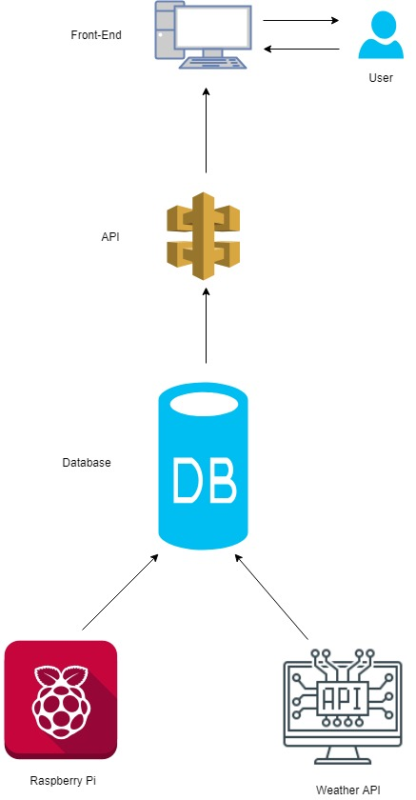
This is a general diagram of how data is collected and presented to the user
CC

Slide 11
Project Design and Features
The website shows graphs for collected data
Future versions will have options for selecting the source to visualize
CC

Slide 12
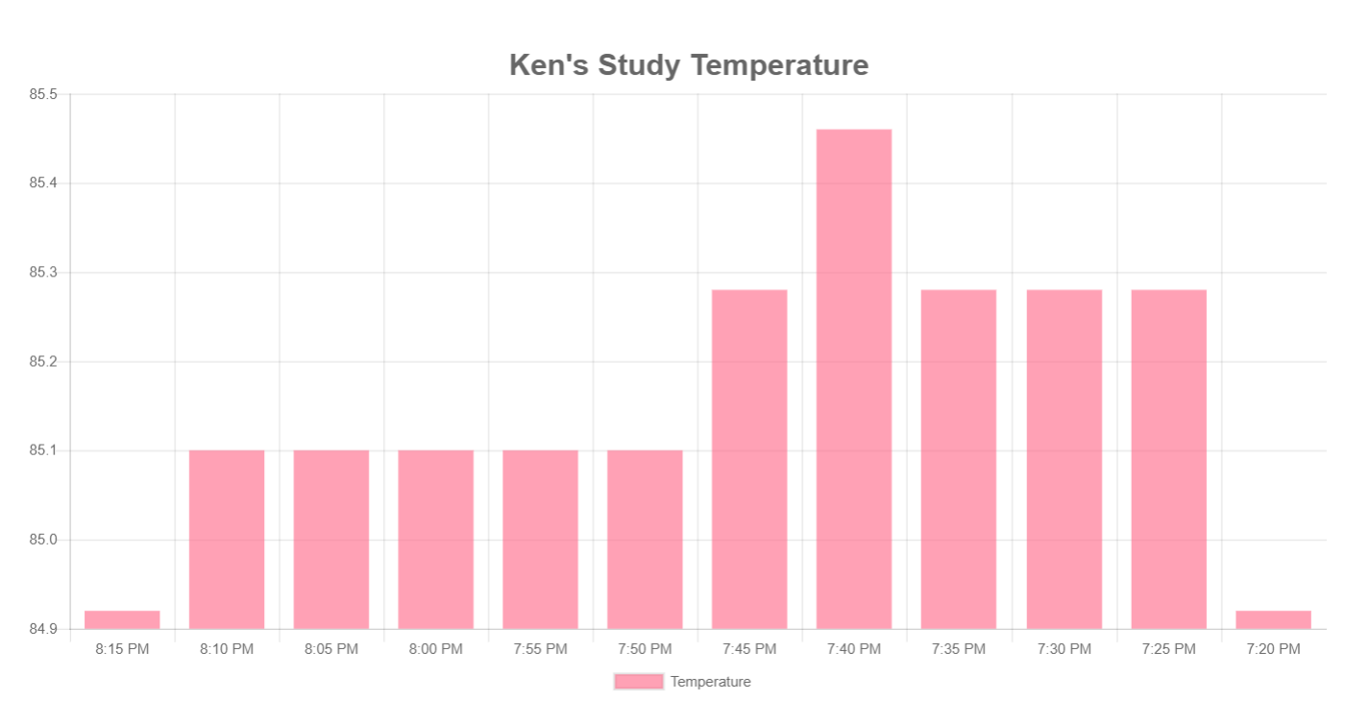
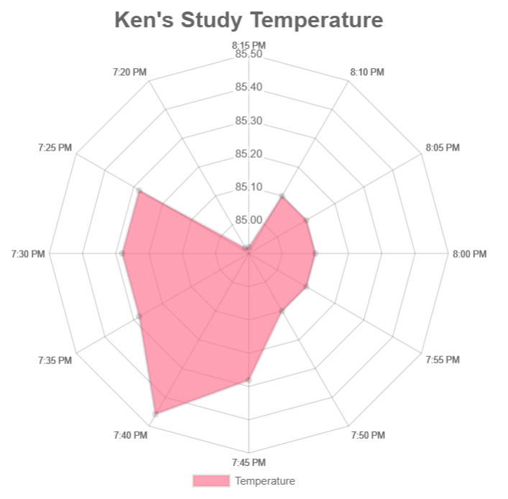
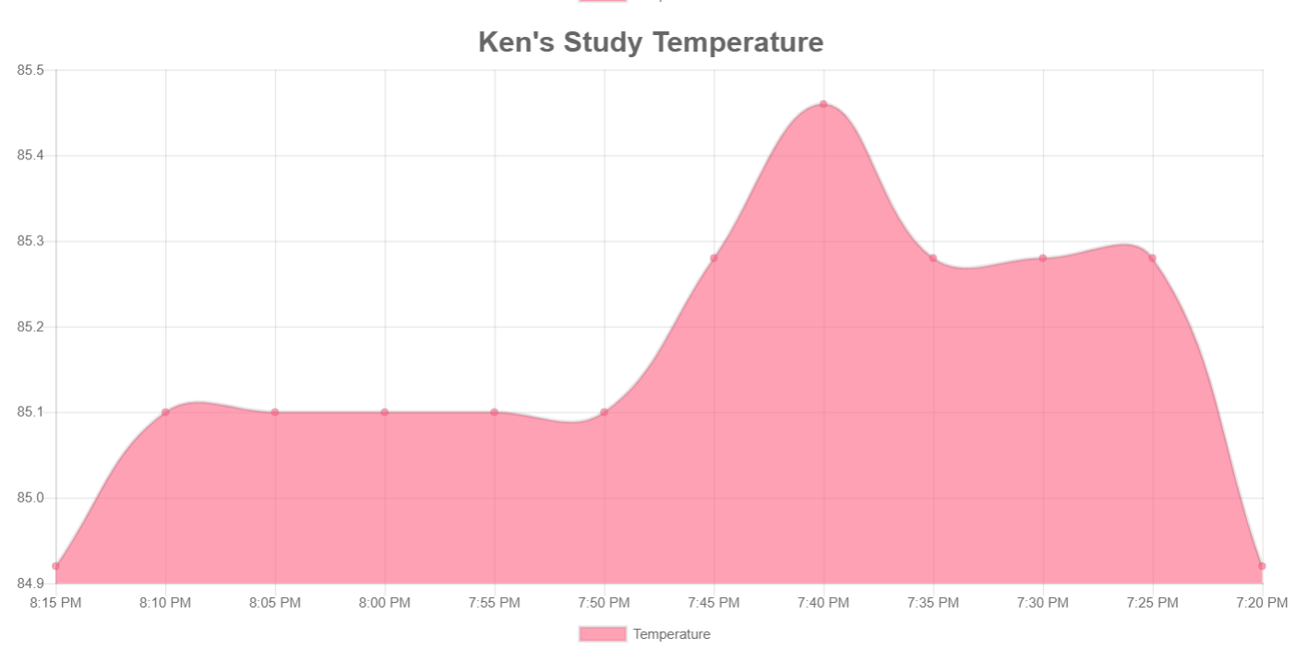
Features
Graph shows last 10 entries
Line Chart
Bar Chart
Radar Chart
CC

Slide 13
Development Progress And Timelines
We have built a functional backend to process and store data
We have built the front end to show the visualizations
We have worked to create an open-ended design that gives us flexibility to add or remove features
KG

Slide 14
Website And Data Presentation
The user facing part of the application consists of a website
This website is a combination of html, css, and javascript, and uses ReactJS
A website was chosen because it gives access to the largest amount of users and has the lowest barrier to entry
KG

Slide 15
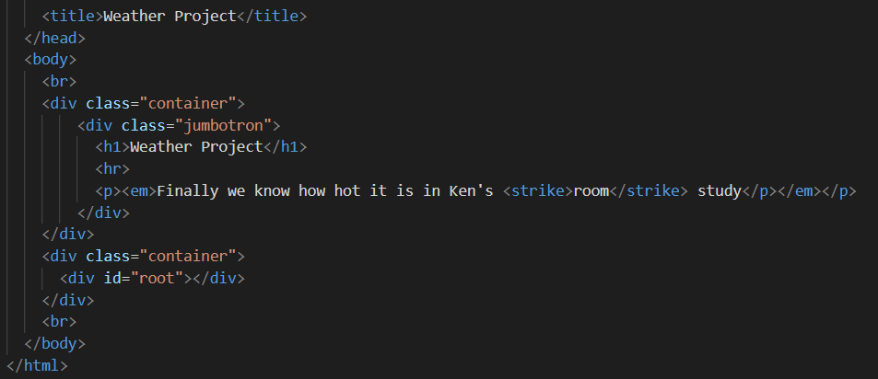
Website Code

Slide 16
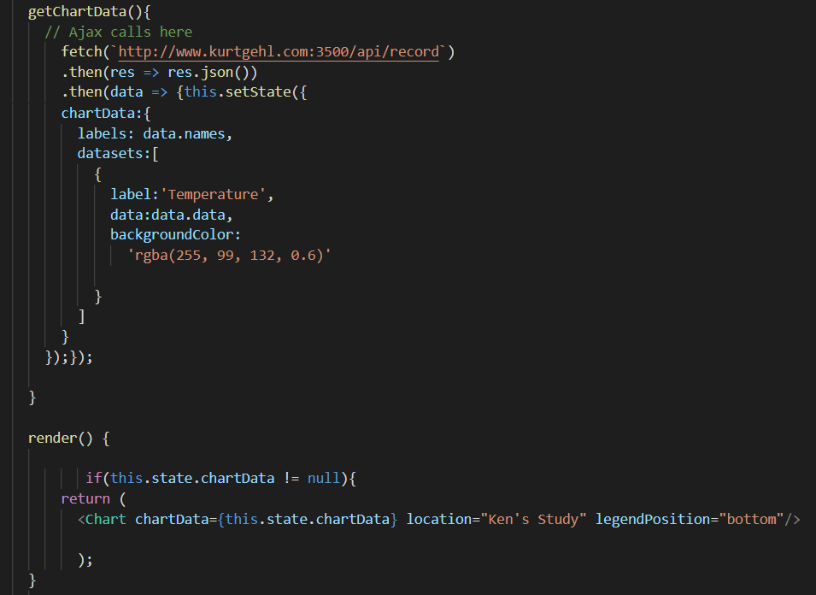

Slide 17
Server And Persistence
Backing the website is a web-based API written in C#
This API is responsible for receiving data from the various weather sources as well as the user’s Raspberry Pi
The API uses Entity Framework to store this data in a SQL server database
KG

Slide 18
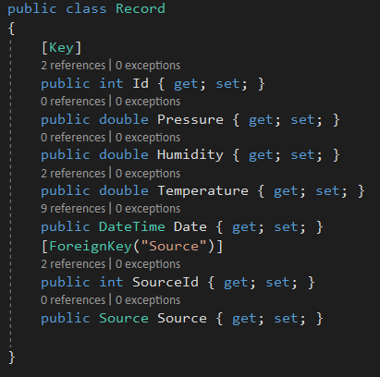
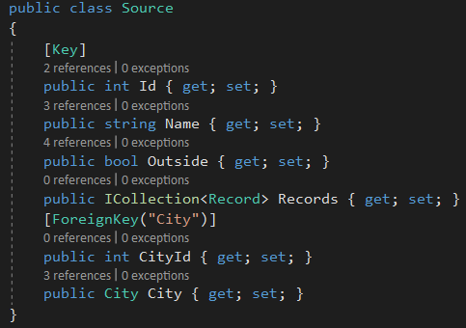
The Backend Code

Slide 19
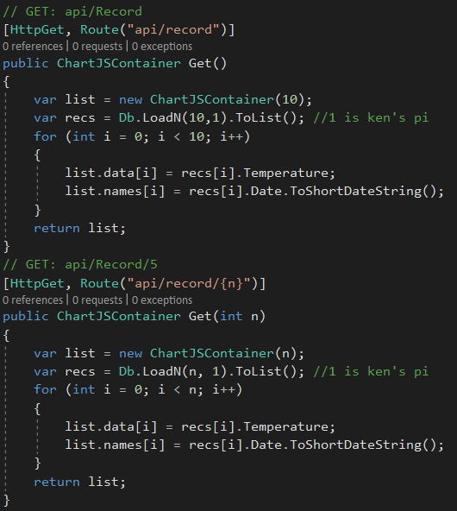
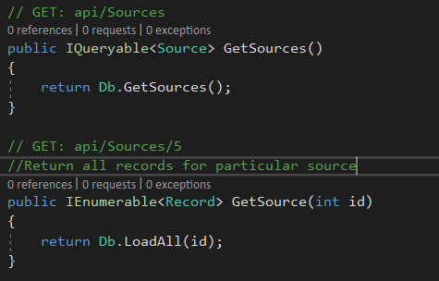
The Backend Code

Slide 20
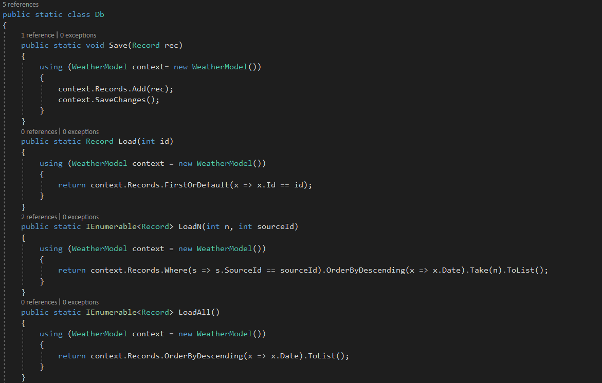

Slide 21
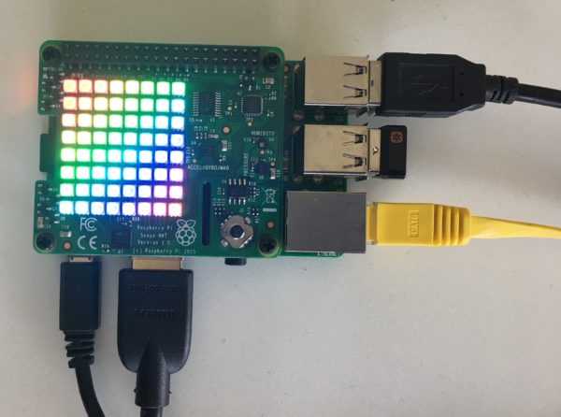
Raspberry Pi And Sense HAT
Sensors for
Temperature
Humidity
Barometric pressure
KF

Slide 22
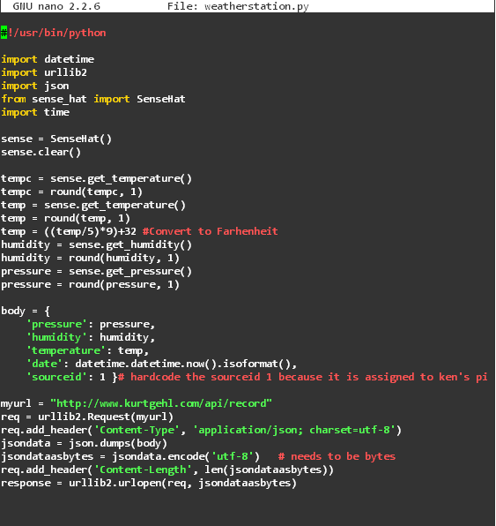
The Pi Script

Slide 23
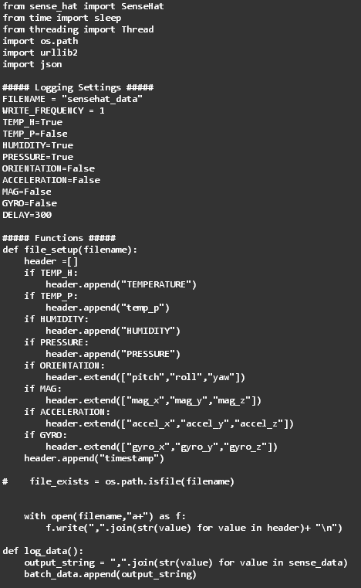
The Pi Script

Slide 24
Future Plans
Analyze indoor vs. outdoor weather data long term
Compare trends in data over time
Incorporate more sensors for additional testing and data intake
Allow collection and graphing of additional measurements
MC

Slide 25
Future Plan Implementation
Equipment needed for future plans
More Raspberry Pis
Sensors for indoor measurements for each additional Pi
Outdoor sensors for full range of data
MC

Slide 26
Future Plan Implementation
Individual tasks
Purchase equipment
Determine locations for sensors
Create additional graphing functionality
Further analysis of data
Determine new uses for local weather data
MC

